Slide 1

Programming Paradigms
“An algorithm is a finite answer to an infinite number of questions.”
-Stephen Cole Kleene
CS 3022 – Syntax
Notes:
Many of these slides were adapted from a course given by Stephen Schulz.

Slide 2
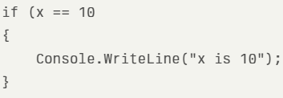


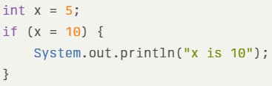

Syntax vs. semantics
Syntax is concerned with the proper arrangement of words in sentences or symbols in expressions.
C#
Python
PHP
Semantics is about the meaning conveyed by the arrangement of words or symbols.
C++
Java
PHP

Slide 3
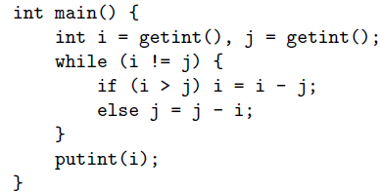
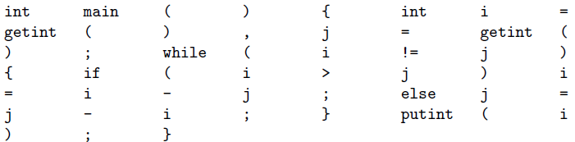
Tokens
Token: The shortest strings of characters with individual meaning.

Slide 4
Token construction
To specify tokens, we use the notation of regular expressions. A regular expression is one of the following.
1. A character
2. The empty string, denoted
3. Two regular expressions next to each other, meaning any string generated
by the first one followed by (concatenated with) any string generated by the
second one
4. Two regular expressions separated by a vertical bar ( | ), meaning any string
generated by the first one or any string generated by the second one
5. A regular expression followed by a Kleene star, meaning the concatenation of
zero or more strings generated by the expression in front of the star

Slide 5

Token example - How to make numbers

Slide 6

Token exercise
Create rules for a number you can enter in a calculator. Example:

Slide 7
Token Exercise Hint
Create rules for a number you can enter in a calculator. Example:
number →
integer →
real →
decimal →
exponent →
digit →

Slide 8
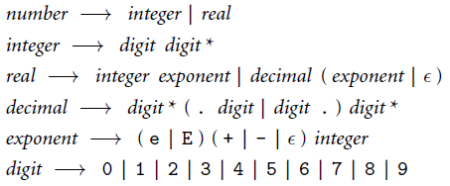
Token Exercise - Answer

Slide 9
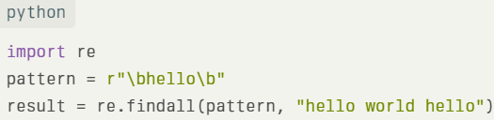

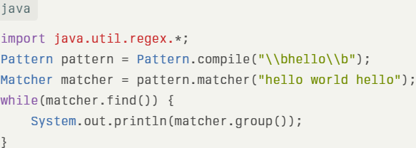

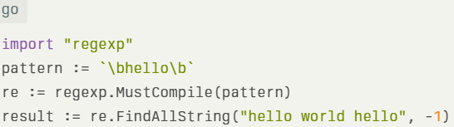
REGular expressions examples

Slide 10
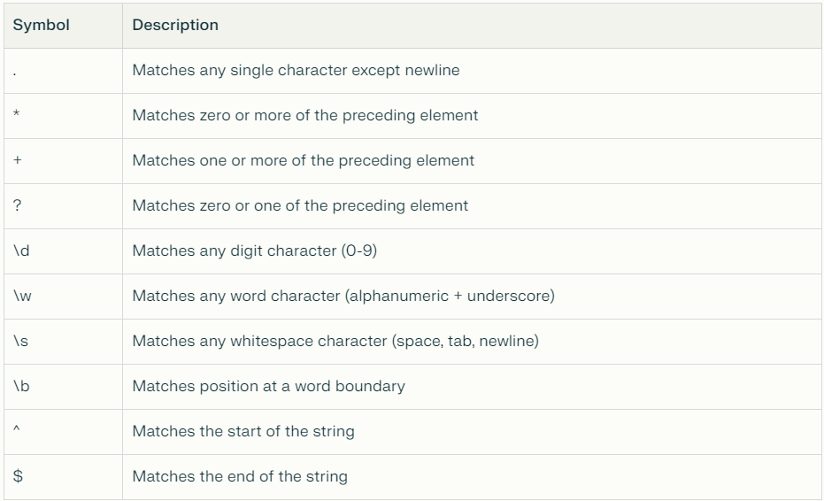
Regex helpful commands

Slide 11
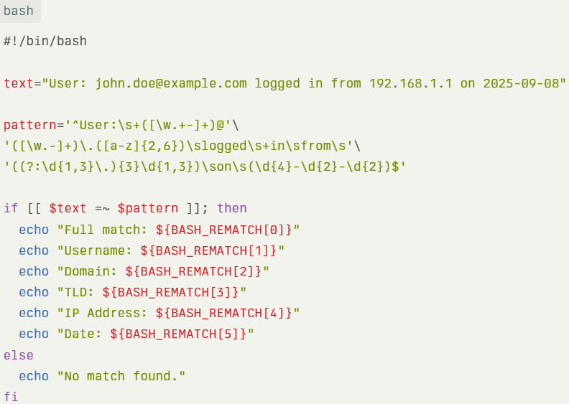
Regex example - BASH

Slide 12

Context free grammars
What is different about this?
* The notation for context-free grammars is sometimes called Backus-Naur Form (BNF), in honor of John Backus and Peter Naur, who devised it for the definition of the Algol-60 programming language

Slide 13
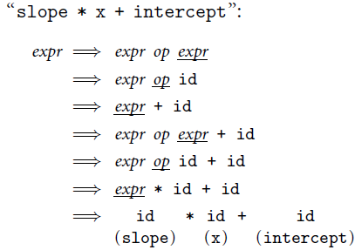
Context free grammar - Derivation

Slide 14
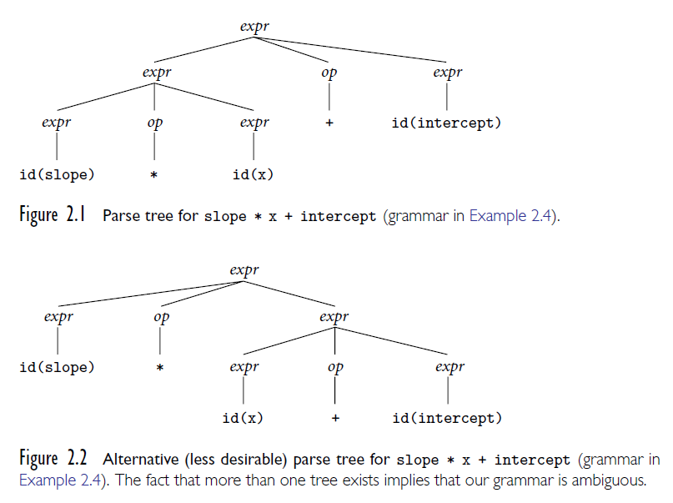
Ambiguity

Slide 15
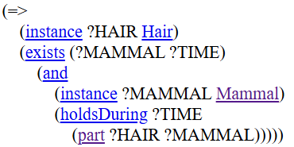
SUO-KIF
Logic based language

Slide 16
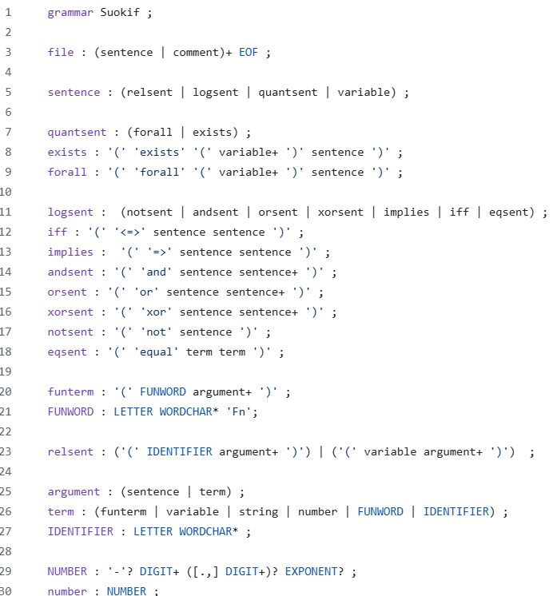
SUOKIF Context Free Grammar
https://github.com/ontologyportal/sigmaAntlr/blob/master/Suokif.g4

